Slide 1



Blockchain
Distributed Ledger Technology
By:- Abhishek Pabbisetty
Narravula Kowsik
Sankalp Khawade

Slide 2
Contents
Literature Survey
Current Scenario
Decentralized System
What is Blockchain?
Chain Model
Why Blockchain?
Potential benefits of Blockchain
Future of Blockchain
Models
System Architecture
Use Cases
Conclusion

Slide 3
Literature Survey

Slide 4
Author/ Date | Topic/Focus | Conceptual Model | Findings | Future Research
Satoshi Nakamoto - 2008 | Bitcoin: A Peer-to-Peer Electronic Cash System | A purely peer-to-peer version of electronic cash would allow online payments to be sent directly from one party to another without going through a financial institution | Peer to Peer Network Concept Distributed Ledger Highly Available Services Decentralized system | Applications other than Digital Money Exchange
A Nash, W Duane, C Joseph - 2001 | PKI: Implementing and Managing E-security | Implement PKI technology and enable secure Web transactions Conduct online business safely by following the implementation techniques found inside this essential guide to PKI technology. Written by the experts at RSA security, this book provides comprehensive coverage of this emerging technology that uses digital certificates to secure Internet transactions. | PKI Technology is revolutionary for secure network communication SSL/TLS Security is cutting edge and HTTPS is the future | Application of PKI in application other than network data exchange PKI based User Authentication
Karen Lewison and Francisco Corella – 24th Oct 2016 | Backing rich Credentials with Blockchain PKI | The paper describes in detail the concept of a blockchain PKI, and shows that it has remarkable advantages over a traditional PKI, notably the fact that revocation checking is performed on the verifier’s local copy of the blockchain | Blockchain based PKI has more advantages than traditional PKI PKI is as strong as Biometrics and if properly implemented more secure | User management via PKI Decentralized user database Blockchain PKI Applications

Slide 5
Author/ Date | Topic/Focus | Conceptual Model | Findings | Future Research
Guy Zyskind, Oz Nathan, Alex 'Sandy' Pentland - 2015 | Decentralizing Privacy: Using Blockchain to Protect Personal Data | Description of a decentralized personal data management system that ensures users own and control their data. A protocol that turns a block chain into an automated access-control manager that does not require trust in a third party | Exponential increase in Data breaches Central Target source of all Third parties collect massive data difficult to handle and safeguarded Online data storage on blockchain | Dynamic Applications Sensitive data dandling Confidentiality Models Data recovery Risk Mitigation Assurance Reliability
Louise Axon and Michael Goldsmith | PB-PKI: a Privacy-Aware Blockchain-Based PKI | System provides a desirable security properties; however, since PKI Blockchain link entities publicly with public keys, they are unsuited to applications in which a level of privacy is required. In PKI applications such as the Internet of Things (IoT), ad-hoc networks and smart cards, preventing tracing of entities and their actions is important | PKI Implementation in Blockchain is Highly Promising Cannot be used for applications requiring privacy Cannot be used for user Private Data Store | Need to build a model that can handle Private data Non disclosure of information Data Confidentiality
Alexander Yakubov ∗ , Wazen M. Shbair ∗ , Anders Wallbom † , David Sanda † , Radu State ∗ - April 2018 | A Blockchain-Based PKI Management Framework | A blockchain-based PKI management framework for issuing, validating and revoking X.509 certificates. Evaluation and experimental results confirm that the proposed framework provides more reliable and robust PKI systems with modest maintenance costs | PKI is exposed to risks due to potential failures of Certificate Authorities Many recent breaches show that if a CA is compromised PKI is more reliable in Blockchain Infra | PKI Based User Authentication

Slide 6



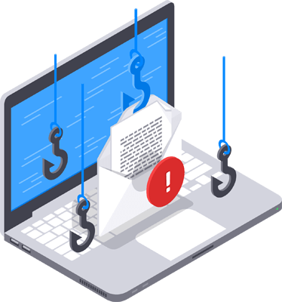
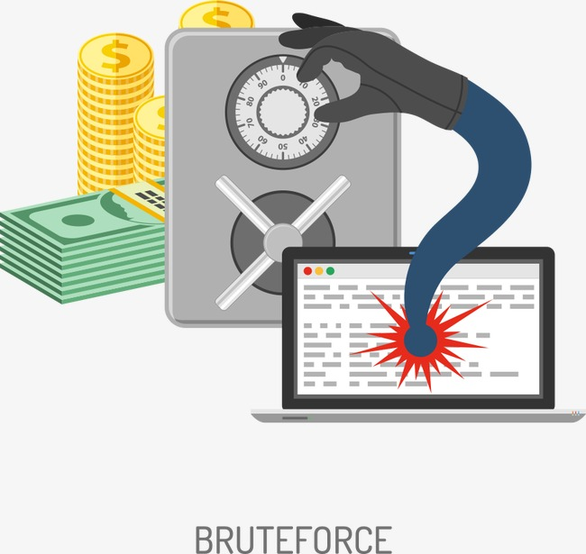

Types of Attack

Slide 7
Biggest reason for all these attacks?

Slide 8
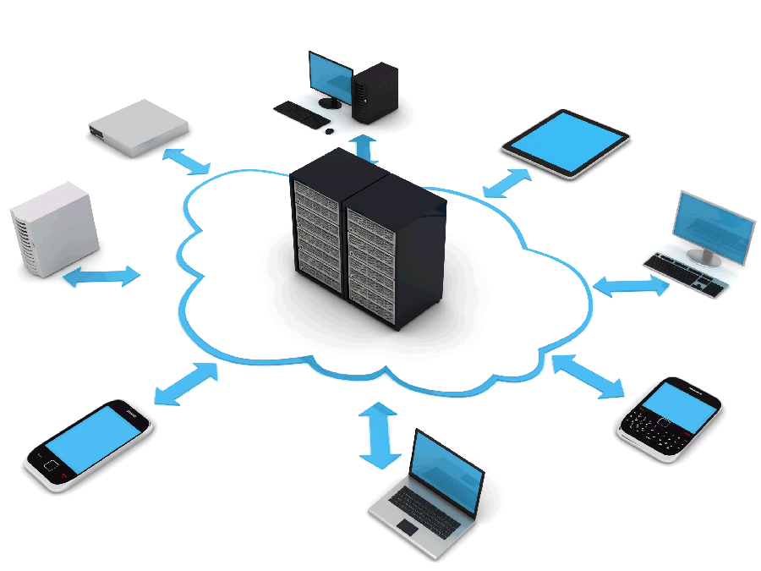
Current Scenario

Slide 9
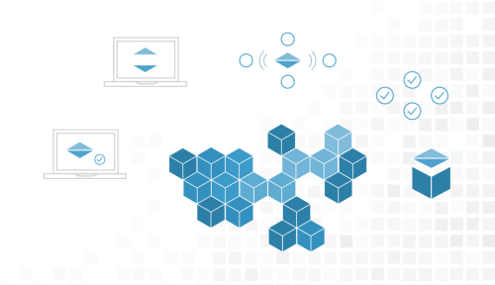
Blockchain Decentralized Ledger

Slide 10
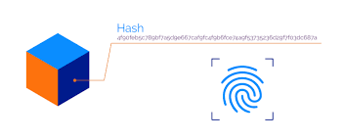

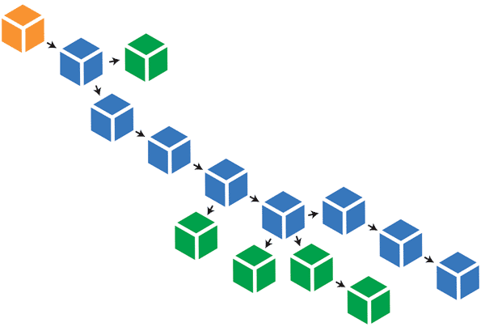
Chain Model
1 – Hash Chain
2 – Information chain
3 – Request chain
4 – Blocked users Chain
5 – Log Chain

Slide 11
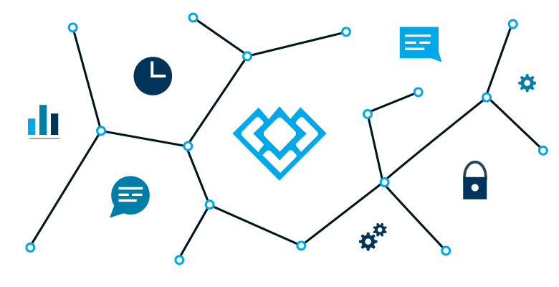
What if system is distributed?…

Slide 12
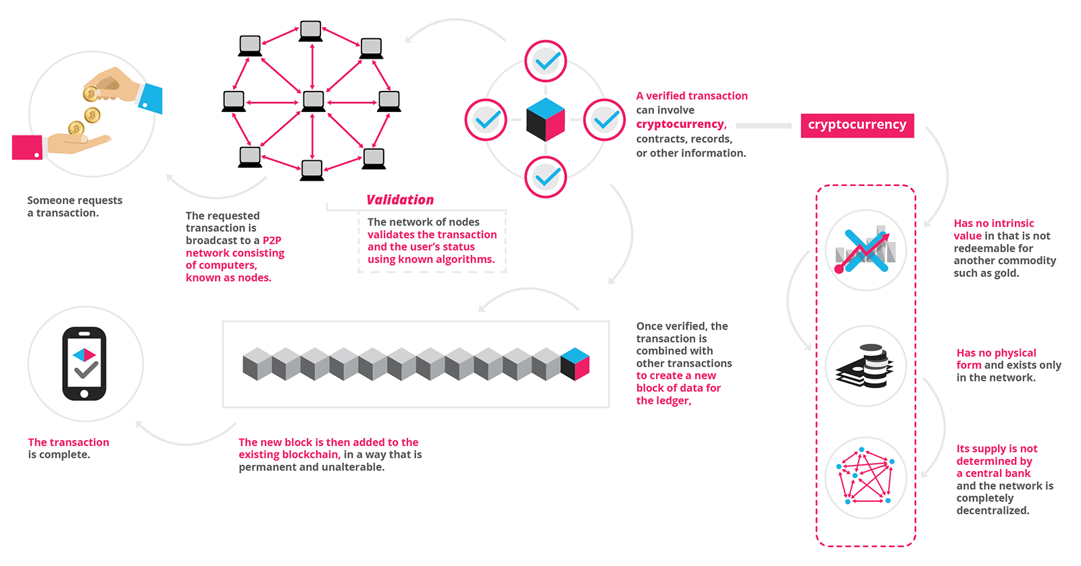
Blockchain

Slide 13
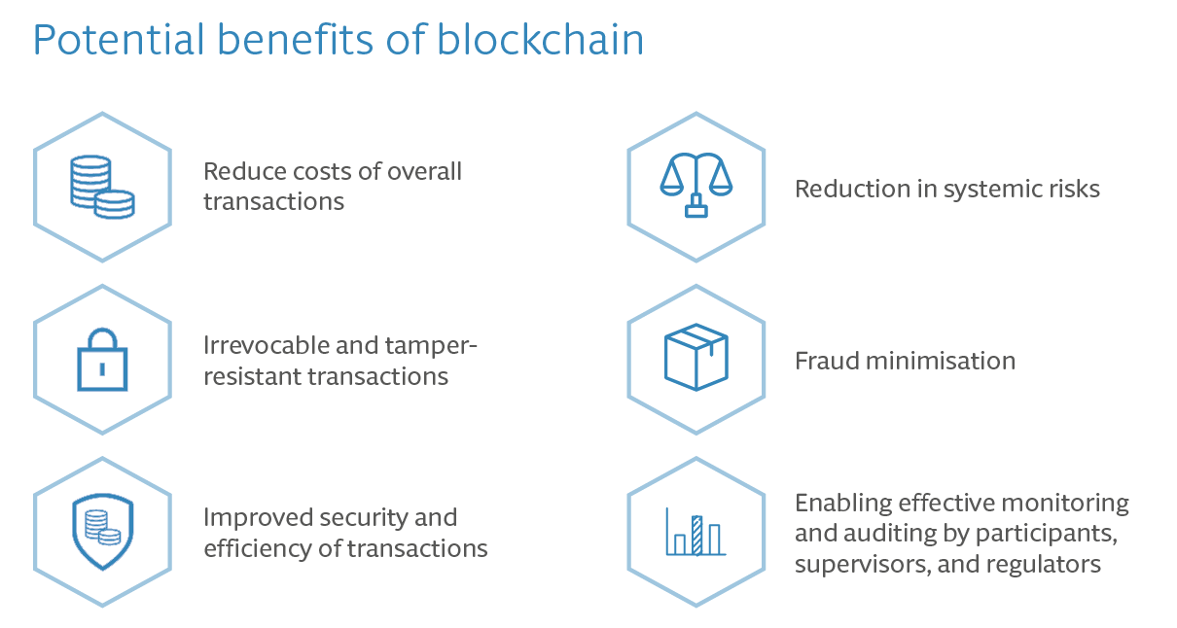

Slide 14
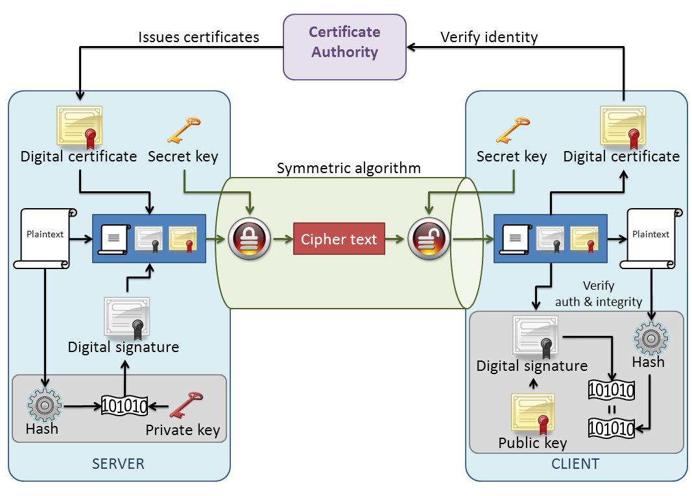
PKI

Slide 15
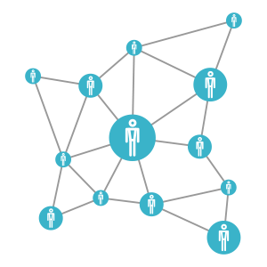


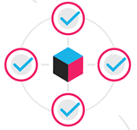




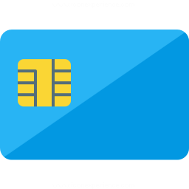






Example
Enters the key and Request is generated for authentication
Blockchain verification and authentication
verification and authenticated
User with the Private Key
Handled case 1
Access acquired
Disabled account or Theft detection List
Key Mismatch
The blockchain verification failed
No Authentication and request device and location information is recorded
No Authentication and device sent with original copy of chain to be replaced
No Auth

Slide 16
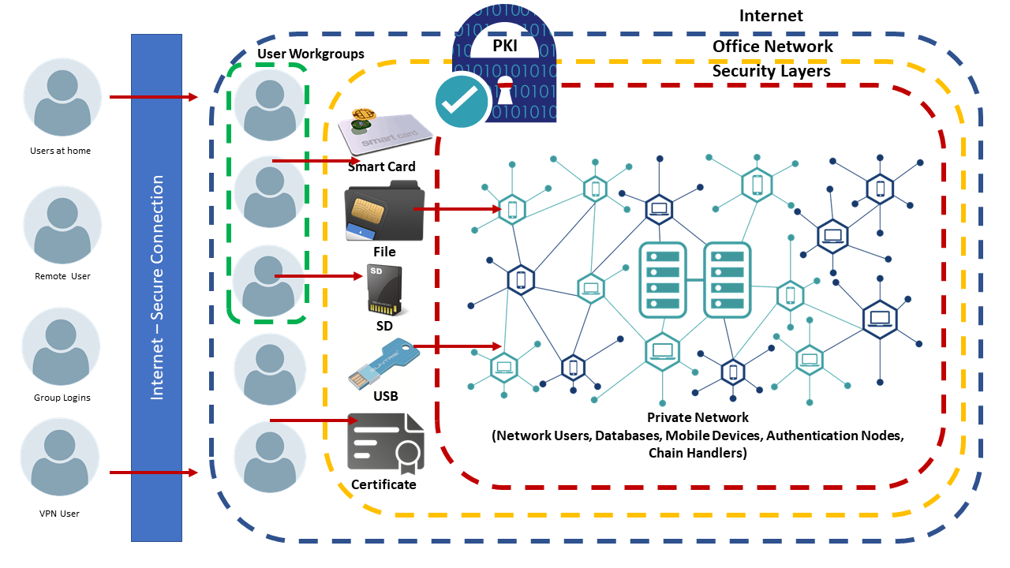
Architecture

Slide 17
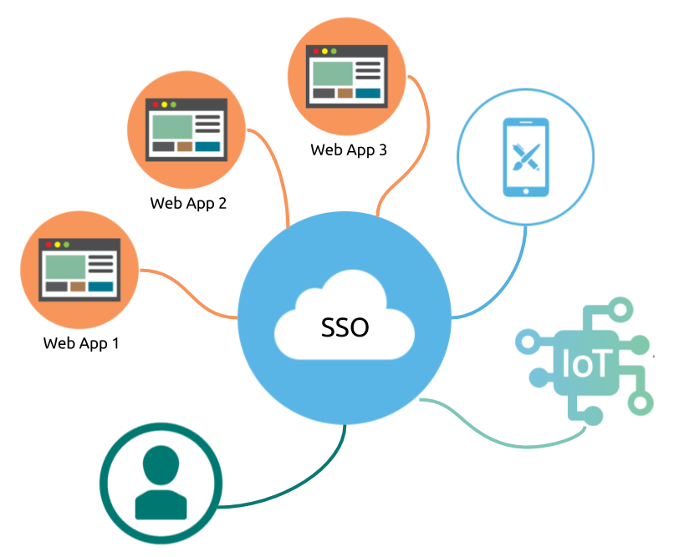
Use Cases

Slide 18
Conclusion

Slide 19
References:
Bitcoin: A Peer-to-Peer Electronic Cash System - Satoshi Nakamoto https://bitcoin.org/bitcoin.pdf
Distributed Blockchain-Based Data Protection Framework for Modern Power Systems against Cyber Attacks - Gaoqi Liang http://www.blockchainresearchnetwork.org/wp-content/uploads/2018/04/Liang-et-al.-2018-Distributed-Blockchain-Based-Data-Protection-Frame.pdf
Distributed Public Key Infrastructure (PKI) protocol
and Access Management Dapps – remme https://drive.google.com/file/d/0B1jTRGmj_3khUV9RTERnYzNvaE0/view
A First Look at Identity Management Schemes on the Blockchain - Paul Dunphy and Fabien A. P. Petitcolas https://arxiv.org/ftp/arxiv/papers/1801/1801.03294.pdf
Blog: https://www.traxion.com/blockchain-the-next-authentication-provider/

